Slide 1


SHOPPING TREND ANALYSIS
PRESENTED BY :
BHARATH SIMHA NAIDU M

Slide 2

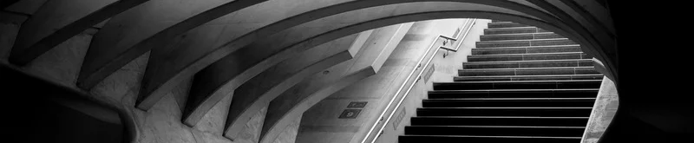
Agenda
PROBLEM STATEMENT | 3
DATA REQUIRMENTS | 4
DATA COLLECTION | 5
DATA VALIDATION | 6
DATA CLEANING | 7
TOOLS USED | 8
GRAPHS & INSIGHTS | 9
DASHBOARD | 10

Slide 3

PROBLEM STATEMENT
Analyzing Customer Shopping Trends and Patterns

Slide 4

CATEGORY
GENDER
ITEM PURCHASED
LOCATION
SEASON
DISCOUNT
PRICE
SHIPPING TYPE
SIZE
PROMO CODE
PAYMENT METHOD
DATA REQUIRMENTS

Slide 5
Back to Agenda
DATA COLLECTION
Primary data given by examiner.

Slide 6

DATA VALIDATION
Data which I got is valid.
No validation required.

Slide 7
No data cleaning required as i got the clean data from reliable source
DATA CLEANING
If required we can use these tools :
python
SQL
tableau
power BI

Slide 8
Power BI was the tool that im using to analyse this data
TOOLS USED

Slide 9

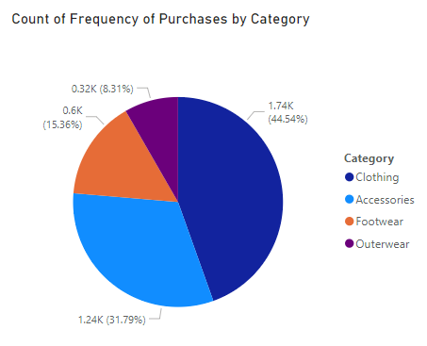
PURCHASE FREQUENCY BY CATEGORY
Clothing is more booming shopping sector and most people are going for clothes .

Slide 10
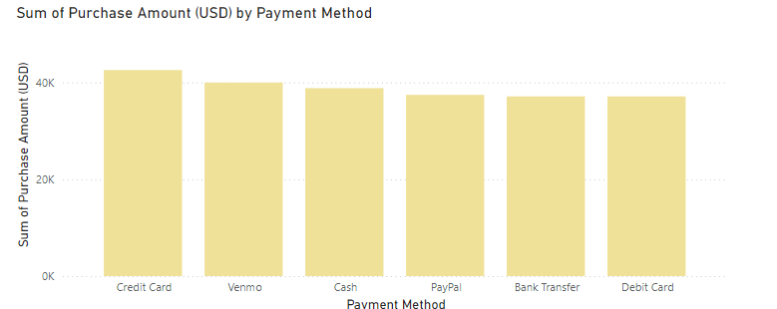
AMOUNT BY PAYMENT METHOD
Most no of people are preffering credit card so adding some extra credit benefits may attract more customers.

Slide 11
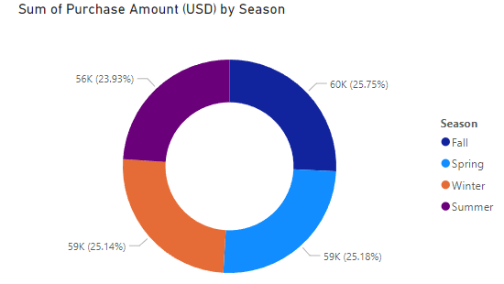
SHOPPERS BY SEASON
Highest amount of sales are happening in fall season.

Slide 12
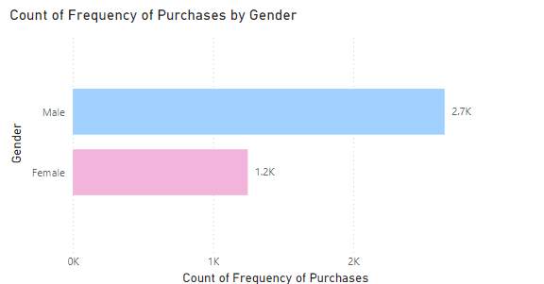
FREQUENCY OF PURCHASE BY GENDER
Males are more frequently buying so try adding more men fashined clothes to increase sales and also try some different varities to attract females.

Slide 13
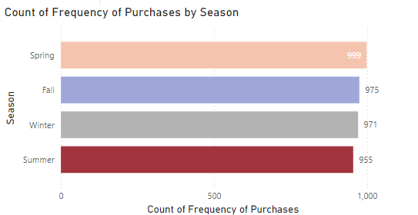
FREQUENCY OF PURCHASE BY SEASON
More people are showing in interest to buy in spring season if we give some extra discount in that season we may get some extra sales

Slide 14
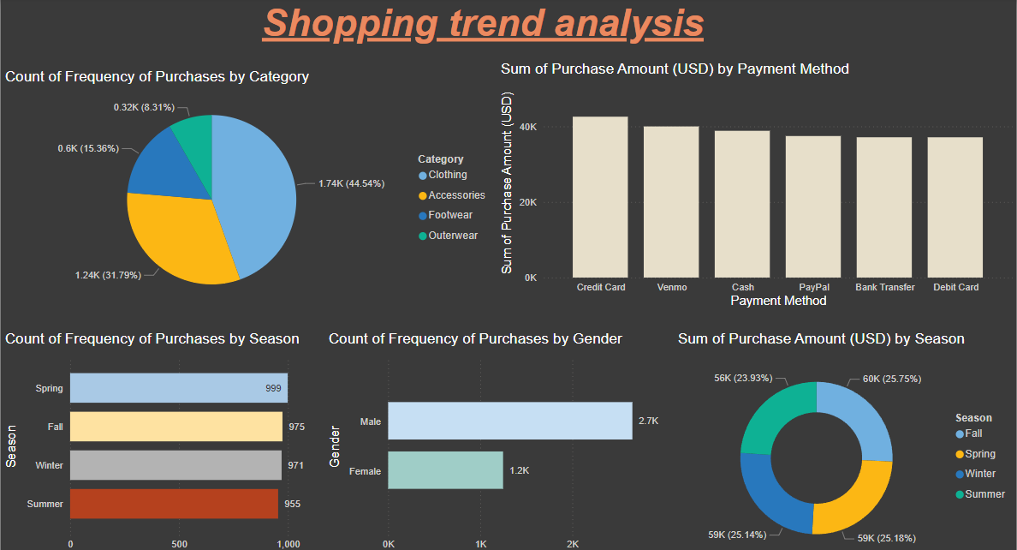
DASHBOARD:
Briefly elaborate on what you want to discuss.

